Slide 1
Software Requirements Engineering
By
Abid Ali
BS Software Engineering
5th
Lecture #15

Slide 2
Understanding User Requirements

Slide 3
Agenda
Use cases and user stories. . . . . . . . . . . . . . . . .
The use case approach. . . . . . . . . . . . . . . . . . . .
Use cases and usage scenarios. . . . .
Identifying use cases. . . . . . . . . . . . . . . . . . . . . .

Slide 4
Use cases and user stories
A use case describes a sequence of interactions between a system and an external actor that results in the actor being able to achieve some outcome of value.
The names of use cases are always written in the form of a verb followed by an object.
Select strong, descriptive names to make it evident from the name that the use case will deliver something valuable for some user.
Table 8-1 lists some sample use cases from a variety of applications

Slide 5
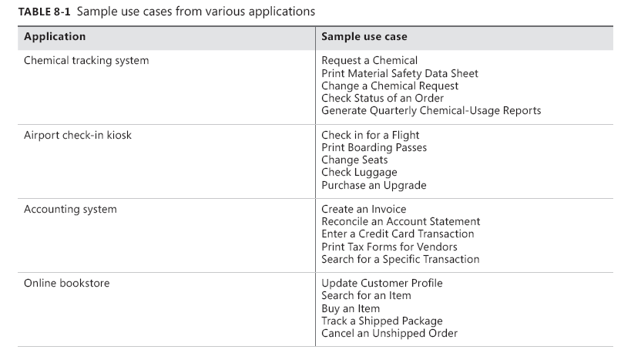
Cont..

Slide 6
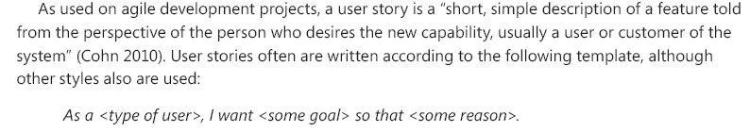
Cont..

Slide 7
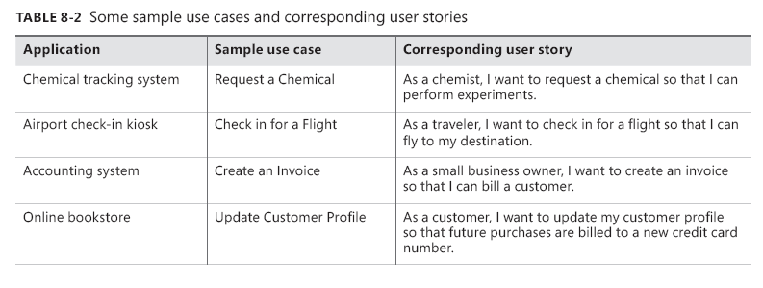
Cont..

Slide 8
Cont..
At this level, use cases look much like user stories.
Both are focused on understanding what different types of users need to accomplish through interactions with a software system.
However, the two processes move in different directions from these similar starting points, as illustrated in Figure 8-1.
Both approaches can also produce other deliverables, such as visual analysis models, but Figure 8-1 illustrates the core distinction.

Slide 9
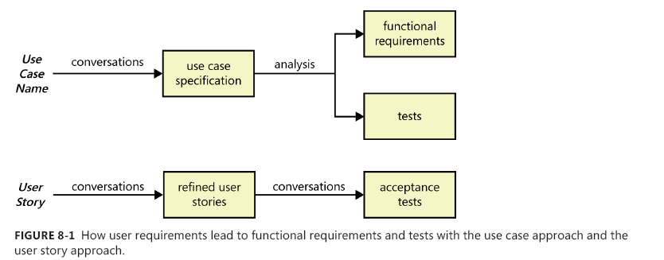
Cont..

Slide 10
The use case approach
Use case diagrams provide a high-level visual representation of the user requirements.
The box frame represents the system boundary.
Arrows from each actor (stick figure) connect to the use cases (ovals) with which the actor interacts.
An arrow from an actor to a use case indicates that he is the primary actor for the use case.
The primary actor initiates the use case and derives the main value from it.
An arrow goes from a use case to a secondary actor, who participates somehow in the successful execution of the use case.
Other software systems often serve as secondary actors, contributing behind the scenes to the use case execution.

Slide 11
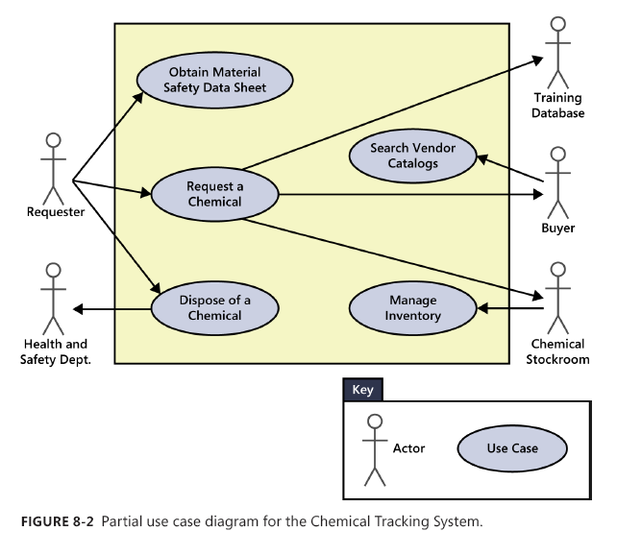
Cont..

Slide 12
Use cases and usage scenarios
A use case describes a discrete, standalone activity that an actor can perform to achieve some outcome of value.
A use case might encompass a number of related activities having a common goal.
A scenario is a description of a single instance of usage of the system.
A use case is therefore a collection of related usage scenarios, and a scenario is a specific instance of a use case.
When exploring user requirements, you can begin with a general use case statement and develop more specific usage scenarios, or you can generalize from a specific scenario example to the broader use case.

Slide 13
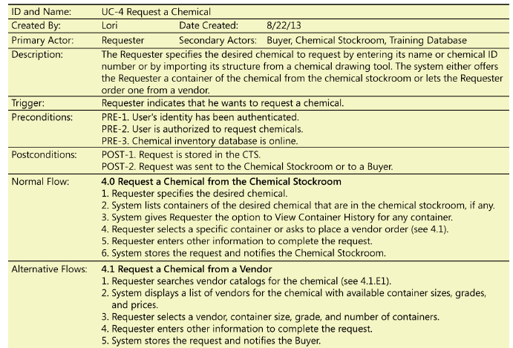
Partial specification of the Chemical Tracking System’s “Request a Chemical” use case.

Slide 14
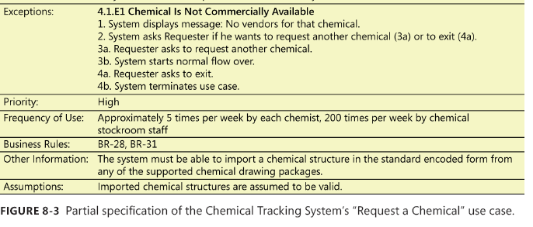
Cont..

Slide 15
The essential elements of a use case
A unique identifier and a succinct name that states the user goal
A brief textual description that describes the purpose of the use case
A trigger condition that initiates execution of the use case
Zero or more preconditions that must be satisfied before the use case can begin
One or more postconditions that describe the state of the system after the use case is successfully completed
A numbered list of steps that shows the sequence of interactions between the actor and the system—a dialog—that leads from the preconditions to the postconditions

Slide 16
Preconditions and postconditions
Preconditions define prerequisites that must be met before the system can begin executing the use case. The system should be able to test all preconditions to see if it’s possible to proceed with the use case.

Slide 17
Cont..
Postconditions describe the state of the system after the use case executed successfully.
Postconditions can describe:
Something observable to the user (the system displayed an account balance).
Physical outcomes (the ATM has dispensed money and printed a receipt).
Internal system state changes (the account has been debited by the amount of a cash withdrawal, plus any transaction fees).

Slide 18
Normal flows, alternative flows, and exceptions
One scenario is identified as the normal flow of events for the use case. It’s also called the main flow, basic flow, normal course, primary scenario, main success scenario, sunny-day scenario, and happy path.
Other success scenarios within the use case are called alternative flows or secondary scenarios.
Alternative flows deliver the same business outcome (sometimes with variations) as the normal flow but represent less common or lower-priority variations in the specifics of the task or how it is accomplished.

Slide 19
Cont..
Conditions that have the potential to prevent a use case from succeeding are called exceptions.
Exceptions describe anticipated error conditions that could occur during execution of the use case and how they are to be handled.
In some cases, the user can recover from an exception, perhaps by re-entering some data that was incorrect.
In other situations, though, the use case must terminate without reaching its success conditions

Slide 20
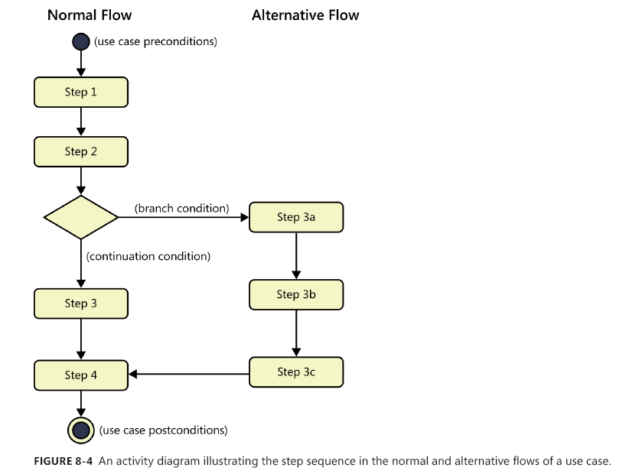
Cont..

Slide 21
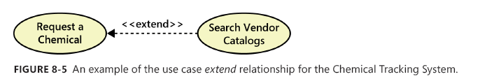
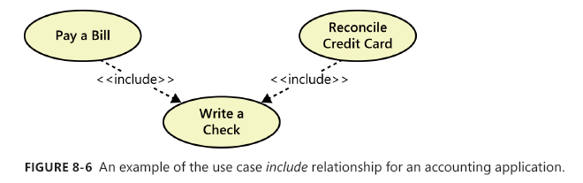
Extend and include
You can show two types of relationships, called extend and include, between use cases in a use case diagram.

Slide 22
Aligning preconditions and postconditions
In many applications, the user can chain together a sequence of use cases into a “macro” use case that describes a larger task.
Some use cases for an e-commerce website might be “Search Catalog,” “Add Item to Shopping Cart,” and “Pay for Items in Shopping Cart.” If you could perform each of these activities independently, they are individual use cases
To make this process work, each use case must leave the system in a state that enables the user to commence the next use case immediately.
That is, the postconditions of one use case must satisfy the preconditions of the next one in the sequence.
Similarly, in a transaction-processing application such as an ATM, each use case must leave the system in a state that permits the next transaction to begin.

Slide 23
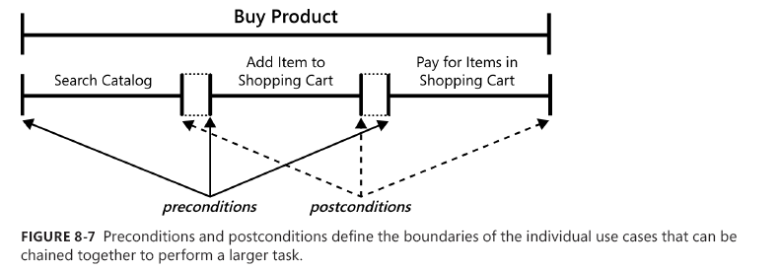
Cont..

Slide 24
The End
Thank you

